Slide 1

CSE 411: Artificial Intelligence
Topic – 4: Informed Search and Exploration
Department of Computer Science and Engineering
Daffodil International University
Notes:
‹#›

Slide 2
Topic Contents
Informed (Heuristic) Search Strategies
Heuristic Functions
Local Search Algorithms and Optimization
Problems
Hill-climbing search
Simulated annealing search
Local beam search
Genetic algorithms
Notes:
‹#›

Slide 3

Best-First Search
Node is selected for expansion based on an evaluation function f(n)
Evaluation function estimates distance to the goal
Choose node which appears best
Implementation:
fringe is a priority queue sorted in ascending order of f-values
‹#›

Slide 4
A Heuristic Function h(n)
Dictionary definition: “A rule of thumb, simplification, or educated guess that reduces or limits the search for solutions in domains that are difficult and poorly understood”
For best-first search:
h(n) = estimated cost of the cheapest path from node n to goal node
‹#›

Slide 5

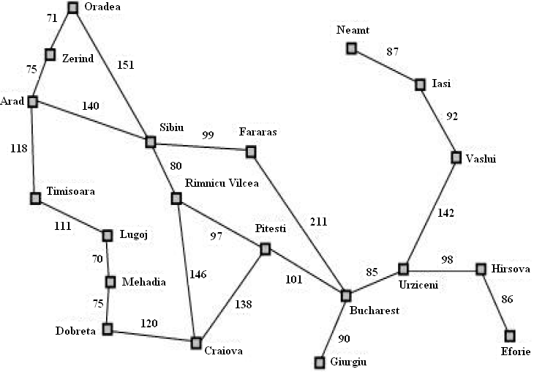
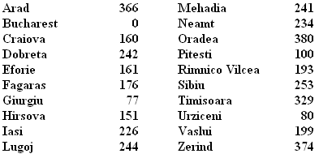
Romania with Step Costs in Km
h_{SLD} = straight-line distance heuristic
h_{SLD} cannot be computed from the problem description itself
In greedy best-first search f(n)=h(n)
Expand node that is closest to goal
‹#›

Slide 6
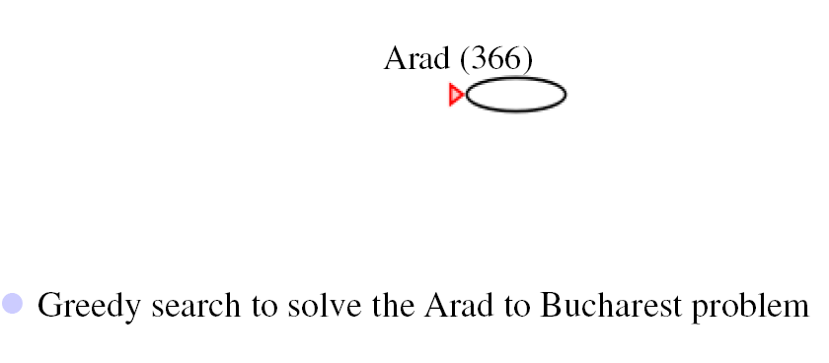
Greedy Search: Example
‹#›

Slide 7
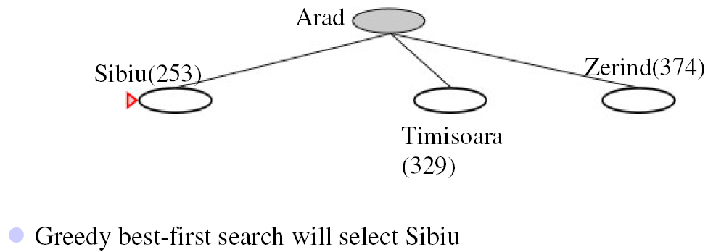
Greedy Search: Example
‹#›

Slide 8
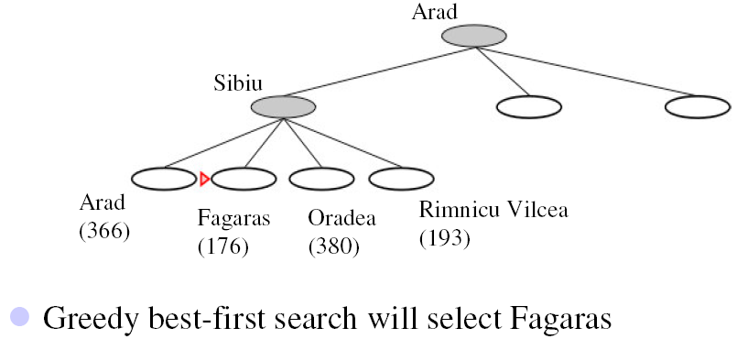
Greedy Search: Example
‹#›

Slide 9
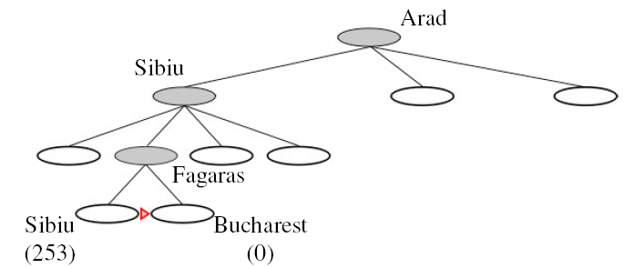
Greedy Search: Example
Goal reached
For this example no node is expanded that is not on the solution path
But not optimal (see Arad, Sibiu, Rimnicu Vilcea, Pitesti)
‹#›

Slide 10
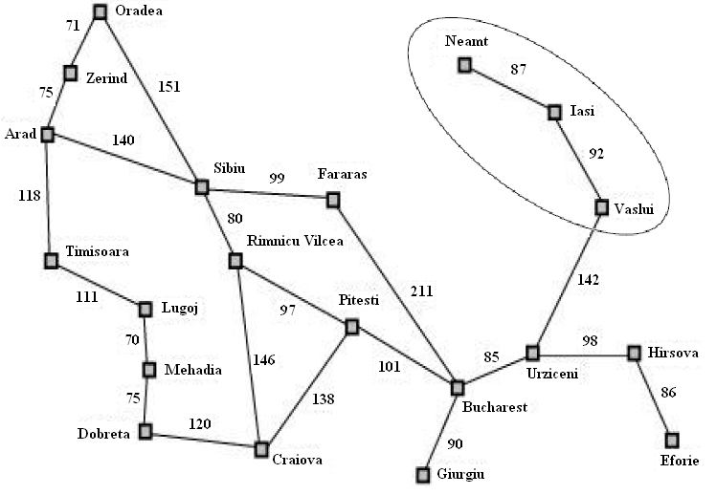
Greedy Search: Evaluation
Complete or optimal: no
Minimizing h(n) can result in false starts, e.g. Iasi to Fagaras
Check on repeated states
‹#›

Slide 11
Greedy Search: Evaluation
Time and space complexity:
In the worst case all the nodes in the search tree are generated: O(b^{m} )
(m is maximum depth of search tree and b is branching factor)
But: choice of a good heuristic can give dramatic improvement
‹#›
Notes:
‹#›

Slide 12
A* Search
Best-known form of best-first search
Idea: avoid expanding paths that are already expensive
Evaluation function f(n)= g(n) + h(n)
g(n): the cost (so far) to reach the node
h(n): estimated cost to get from the node to the goal
f(n): estimated total cost of path through n to goal
A* search is both complete and optimal if h(n) satisfies certain conditions
‹#›

Slide 13
A* Search
A* search is optimal if h(n) is an admissible heuristic
A heuristic is admissible if it never overestimates the cost to reach the goal
h(n) ≤ h*(n) where h*(n) is the true cost from n
Admissible heuristics are optimistic about the cost of solving the problem
e.g. h_{SLD}(n) never overestimates the actual road distance
‹#›

Slide 14

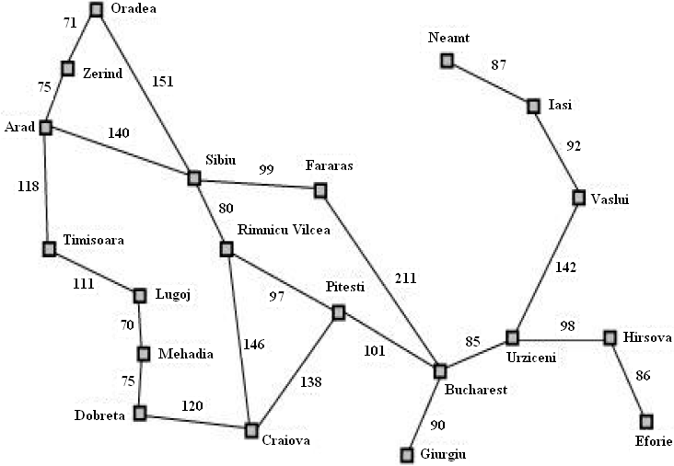
Romania Example
‹#›

Slide 15

A* Search: Example
‹#›

Slide 16
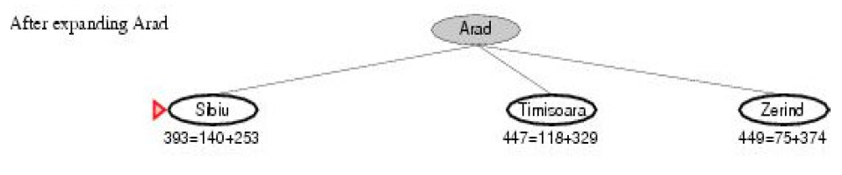
A* Search: Example
‹#›

Slide 17
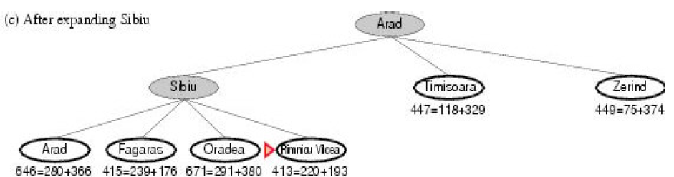
A* Search: Example
‹#›

Slide 18
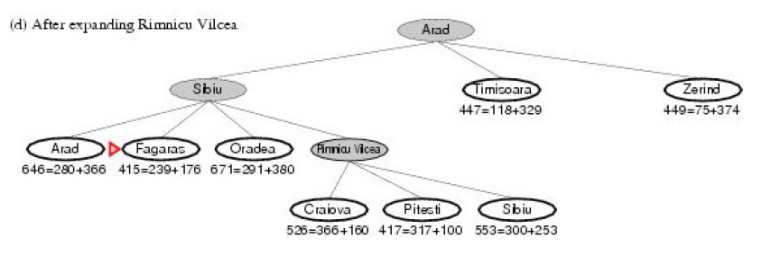
A* Search: Example
‹#›

Slide 19
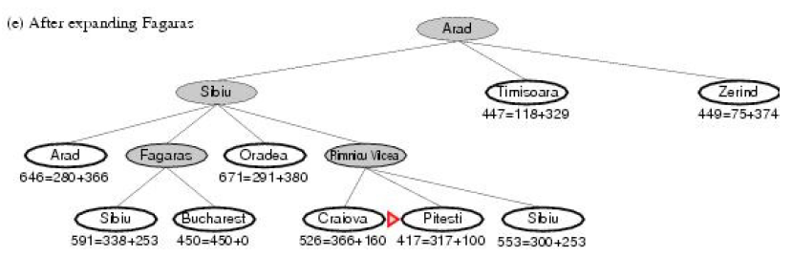
A* Search: Example
‹#›

Slide 20
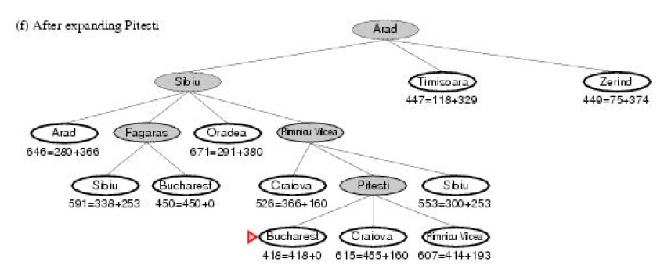
A* Search: Example
‹#›

Slide 21

Optimality of A*
Suppose a suboptimal goal node G₂ appears on the fringe and let the cost of the optimal solution be C*.
Since G₂ is suboptimal and
h(G₂) = 0 (true for any goal node),
we know that f(G₂) = g(G₂) + h(G₂) = g(G₂) > C*
Now consider a fringe node n that is on an optimal solution path.
If h(n) does not overestimate the cost of completing the solution path,
then we know that f(n) = g(n) + h(n) ≤ C*
Since f(n) ≤ C* < f(G₂), G₂ will not be expanded and A* search must return an optimal solution.
‹#›

Slide 22
A* Search: Evaluation
Complete: yes
Unless there are infinitely many nodes with f < f(G)
Optimal: yes
A* is also optimally efficient for any given h(n). That is, no other optimal algorithm is guaranteed to expand fewer nodes than A*.
‹#›

Slide 23
A* Search: Evaluation
Time complexity:
number of nodes expanded is still exponential in length of solution
Space complexity:
All generated nodes are kept in memory
A* usually runs out of space before running out of time
‹#›

Slide 24
Heuristic Functions
Let us see two heuristics for a problem.
‹#›

Slide 25
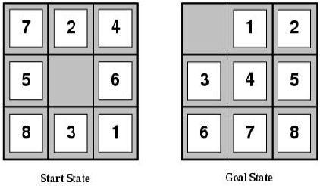
Example: 8-puzzle
States: location of each tile plus blank
Initial state: Any state can be initial
Actions: Move blank {Left, Right, Up, Down}
Goal test: Check whether goal configuration is reached
Path cost: Number of actions to reach goal
‹#›

Slide 26
Example: 8-puzzle
For 8-puzzle problem:
h₁ = number of tiles out of place. In the example h₁= 8
h₂ = total Manhattan distance of errant pieces. In the example
h₂ = 3+1+2+2+2+3+3+2 = 18
‹#›

Slide 27
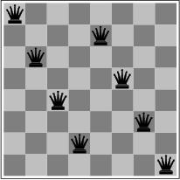

Local Search Algorithms and Optimization Problems
Previously: systematic exploration of search space
Path to goal is solution to problem
for some problem classes, it is sufficient to find a solution
the path to the solution is not relevant, e.g. 8-queens
Different algorithms can be used
Local search
memory requirements can be dramatically relaxed by modifying the current state
all previous states can be discarded
since only information about the current state is kept, such methods are called local
‹#›

Slide 28
Local Search Algorithms and Optimization Problems
Local search = use single current state and move to neighboring states.
Advantages:
Use very little memory
Find often reasonable solutions in large or infinite state spaces.
Are also useful for pure optimization problems.
Find best state according to some objective function.
e.g. survival of the fittest as a metaphor for optimization.
‹#›

Slide 29
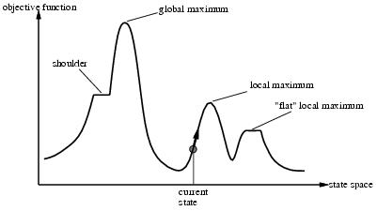
Local Search Algorithms and Optimization Problems
‹#›

Slide 30
Hill-Climbing Search
continually moves uphill
increasing value of the evaluation function
gradient descent search is a variation that moves downhill
is a loop that continuously moves in the direction of increasing value - that is, uphill.
It terminates when a peak is reached.
‹#›

Slide 31
Hill-Climbing Search
Hill-climbing does not look ahead of the immediate neighbors of the current state.
Hill-climbing chooses randomly among the set of best successors, if there is more than one.
Hill-climbing is also called greedy local search
Hill-climbing is a very simple strategy with low space requirements
stores only the state and its evaluation, no search tree
‹#›

Slide 32
Hill-Climbing Example
8-queens problem (complete-state formulation).
Successor function: move a single queen to another square in the same column.
Heuristic function h(n): the number of pairs of queens that are attacking each other (directly or indirectly).
‹#›

Slide 33
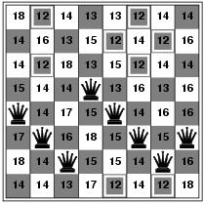
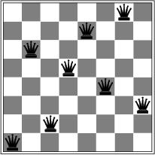
Hill-Climbing Example
(a)
(b)
(a) An 8-queens state with heuristic cost estimate h = 17, showing the value of h for each possible successor obtained by moving a queen within its column. The best moves are marked.
(b) A local minimum in the 8-queens state space; the state has h = 1 but every successor has a higher cost.
‹#›

Slide 34
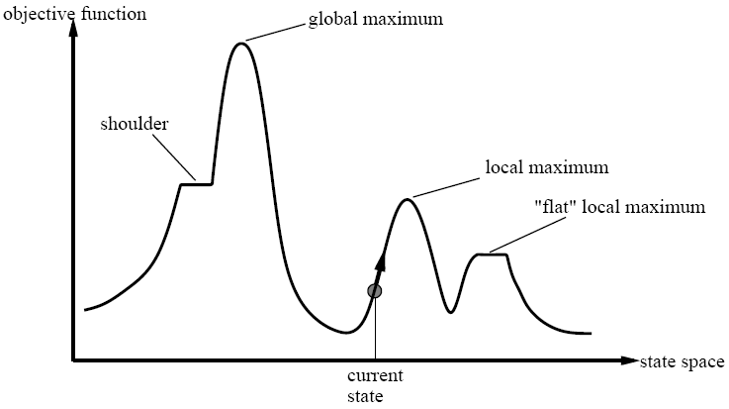
‹#›

Slide 35
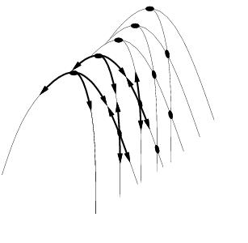
Drawbacks
Ridge = sequence of local maxima difficult for greedy algorithms to navigate
Plateaux = an area of the state space where the evaluation function is flat.
Gets stuck 86% of the time.
‹#›

Slide 36
Hill-Climbing Search
problems
local maxima
algorithm can’t go higher, but is not at a satisfactory solution
plateau
area where the evaluation function is flat
ridges
search may oscillate slowly
‹#›

Slide 37
Escaping Local Optima
HC gets stuck at local maxima limiting the quality of the solution found.
Two ways to modify HC:
choice of neighbor
criteria for accepting neighbor for current
For example:
choose neighbor randomly
accept neighbor if it is better or if it isn't, accept with some fixed probability p
‹#›
Notes:
‹#›

Slide 38
Escaping Local Optima
Modified HC can escape local maxima but:
chance of making a bad move is the same at the beginning of the search as at the end
magnitude of improvement or lack of is ignored
How can HC address these concerns?
fixed probability p that bad move is accepted can be replaced with a probability that decreases as the search proceeds
now as the search progresses, the chances of taking a bad move reduces
‹#›

Slide 39
Hill-Climbing Search
function HILL-CLIMBING( problem) return a state that is a local maximum
input: problem, a problem
local variables: current, a node.
neighbor, a node.
current ← MAKE-NODE(INITIAL-STATE[problem])
loop do
neighbor ← a highest valued successor of current
if VALUE [neighbor] ≤ VALUE[current] then return STATE[current]
current ← neighbor
‹#›

Slide 40
Hill-Climbing Variations
Stochastic hill-climbing
Random selection among the uphill moves.
The selection probability can vary with the steepness of the uphill move.
First-choice hill-climbing
implements stochastic hill climbing by generating successors randomly until a better one is found.
Random-restart hill-climbing
Tries to avoid getting stuck in local maxima.
‹#›

Slide 41
Simulated Annealing
Escape local maxima by allowing “bad” moves.
Idea: but gradually decrease their size and frequency.
Origin; metallurgical annealing
Bouncing ball analogy:
Shaking hard (= high temperature).
Shaking less (= lower the temperature).
If T decreases slowly enough, best state is reached.
Applied for VLSI layout, airline scheduling, etc.
‹#›

Slide 42
Simulated Annealing
function SIMULATED-ANNEALING( problem, schedule) return a solution state
input: problem, a problem
schedule, a mapping from time to temperature
local variables: current, a node.
next, a node.
T, a “temperature” controlling the probability of downward steps
current ← MAKE-NODE(INITIAL-STATE[problem])
for t ← 1 to ∞ do
T ← schedule[t]
if T = 0 then return current
next ← a randomly selected successor of current
∆E ← VALUE[next] - VALUE[current]
if ∆E > 0 then current ← next
else current ← next only with probability e^{∆E /T}
‹#›

Slide 43
Local Beam Search
Keep track of k states instead of one
Initially: k random states
Next: determine all successors of k states
If any of successors is goal → finished
Else select k best from successors and repeat.
Major difference with random-restart search
Information is shared among k search threads.
Can suffer from lack of diversity.
Stochastic variant: choose k successors at proportionally to state success.
‹#›

Slide 44
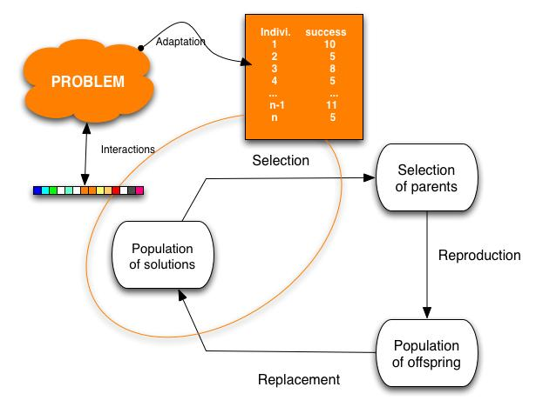
Genetic Algorithms
Variant of local beam search with sexual recombination.
‹#›

Slide 45
Genetic Algorithms
GAs begin with a set of k randomly generated states, called the population.
Each state, or individual, is represented as a string over a finite alphabet—most commonly, a string of 0s and 1s.
For example, an 8-queens state must specify the positions of 8 queens, each in a column of 8 squares, and so requires 8 x log₂ 8 = 24 bits.
Alternatively, the state could be represented as 8 digits, each in the range from 1 to 8.
Figure 4.6(a) shows a population of four 8-digit strings representing 8-queens states.
‹#›

Slide 46
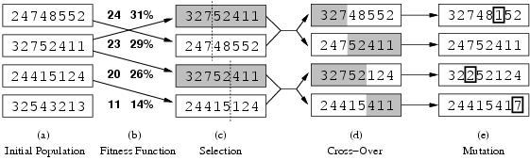
Genetic Algorithms
Figure 4.6: The three major operations in genetic algorithm. The initial population in (a) is ranked by the fitness function in (b), resulting in pairs for mating in (c). They produce offspring in (d), which are subject to mutation in (e).
‹#›

Slide 47
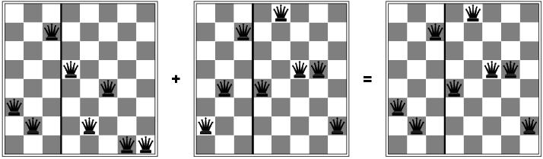
Genetic Algorithms
The 8-queens states involved in this reproduction step are shown in Figure 4.7.
Figure 4.7: The 8-queens states corresponding to the first two parents in Figure 4.6(c) and the first offspring in Figure 4.6(d).
‹#›

Slide 48
Genetic Algorithms
The production of the next generation of states is shown in Figure 4.6(b)–(e).
In (b), each state is rated by the objective function, or (in GA terminology) the fitness function.
A fitness function should return higher values for better states, so, for the 8-queens problem we use the number of nonattacking pairs of queens, which has a value of 28 for a solution.
The values of the four states are 24, 23, 20, and 11.
In this particular variant of the genetic algorithm, the probability of being chosen for reproducing is directly proportional to the fitness score, and the percentages are shown next to the raw scores.
‹#›

Slide 49
Genetic Algorithms
In (c), two pairs are selected at random for reproduction, in accordance with the probabilities in (b).
Notice that one individual is selected twice and one not at all.
For each pair to be mated, a crossover point is chosen randomly from the positions in the string.
In Figure 4.6, the crossover points are after the third digit in the first pair and after the fifth digit in the second pair.
In (d), the offspring themselves are created by crossing over the parent strings at the crossover point.
For example, the first child of the first pair gets the first three digits from the first parent and the remaining digits from the second parent, whereas the second child gets the first three digits from the second parent and the rest from the first parent.
‹#›

Slide 50
Genetic Algorithms
The 8-queens states involved in this reproduction step are shown in Figure 4.7.
Figure 4.7: The 8-queens states corresponding to the first two parents in Figure 4.6(c) and the first offspring in Figure 4.6(d).
‹#›

Slide 51
Genetic Algorithms
The example shows that when two parent states are quite different, the crossover operation can produce a state that is a long way from either parent state.
It is often the case that the population is quite diverse early on in the process, so crossover (like simulated annealing) frequently takes large steps in the state space early in the search process and smaller steps later on when must individuals are quite similar.
‹#›

Slide 52
Genetic Algorithms
Finally, in (e), each location is subject to random mutation with a small independent probability.
One digit was mutated in the first, third, and fourth offspring.
In the 8-queens problem, this corresponds to choosing a queen at random and moving it to a random square in its column.
‹#›

Slide 53
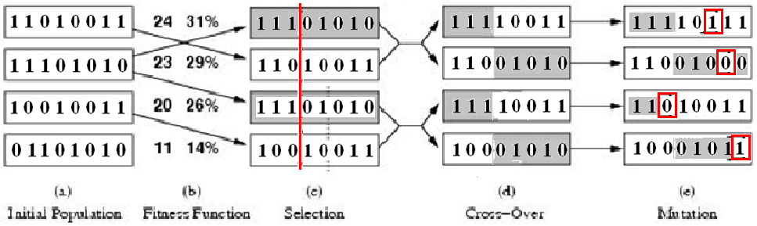
Genetic Algorithms
Figure: A genetic algorithm. The algorithm is the same as the one diagrammed in the figure in slide no. 45, with one variation: in this more popular version, each mating of two parents produces only one offspring, not two.
‹#›

Slide 54
Genetic Algorithms
function GENETIC_ALGORITHM( population, FITNESS-FN) return an individual
input: population, a set of individuals
FITNESS-FN, a function which determines the quality of the individual
repeat
new_population ← empty set
loop for i from 1 to SIZE(population) do
x ← RANDOM_SELECTION(population, FITNESS_FN) y ← RANDOM_SELECTION(population, FITNESS_FN)
child ← REPRODUCE(x,y)
if (small random probability) then child ← MUTATE(child )
add child to new_population
population ← new_population
until some individual is fit enough or enough time has elapsed
return the best individual
‹#›

